Slide 1


K.RAMAKRISHNAN COLLEGE OF TECHNOLOGY (AUTONOMOUS), TRICHY.
Smart Healthcare Monitoring System using IoT and UML
PRESENTED BY
GANAGHASHREE K(2303811710422043)
HARIPRIYA E (2303811710422050)
HARINI S(2303811710422055)
HARSHINI K(2303811710422061)

Slide 2
INTRODUCTION
Healthcare is shifting from traditional manual monitoring to smart IoT-enabled systems for real-time patient tracking.
IoT devices and sensors collect vital data like heart rate, temperature, and oxygen level for continuous monitoring.
The system enables remote healthcare, reducing hospital visits and ensuring timely medical interventions.
UML modeling (usecase, class diagrams) provides a structured design for building a scalable and reliable solution.

Slide 3
EXISTING SYSTEM
Traditional healthcare systems rely on manual check-ups where patients visit hospitals for routine monitoring.
Health parameters are often recorded periodically, which may lead to delayed diagnosis of critical conditions.
Remote monitoring is limited, making it hard for doctors to track patients’ health in real-time.
Lack of smart integration results in increased hospital visits, higher costs, and lower efficiency in patient care.

Slide 4
PROPOSED SYSTEM
The smart healthcare system uses IoT-enabled sensors and devices to continuously monitor patient health data.
Vital signs like heart rate, temperature, and oxygen level are sent to a cloud platform for real-time analysis.
Doctors and caregivers can access patient data remotely, ensuring timely alerts and medical interventions.
Using UML-based design, the system is modeled to be scalable, reliable, and efficient for healthcare services.
HOME
LOGIN
REGISTER
.
TRANSFER THE MONEY TO ANOTHER ACCOUNT
DASHBOARD
UPDATING THE AMOUNT

Slide 5
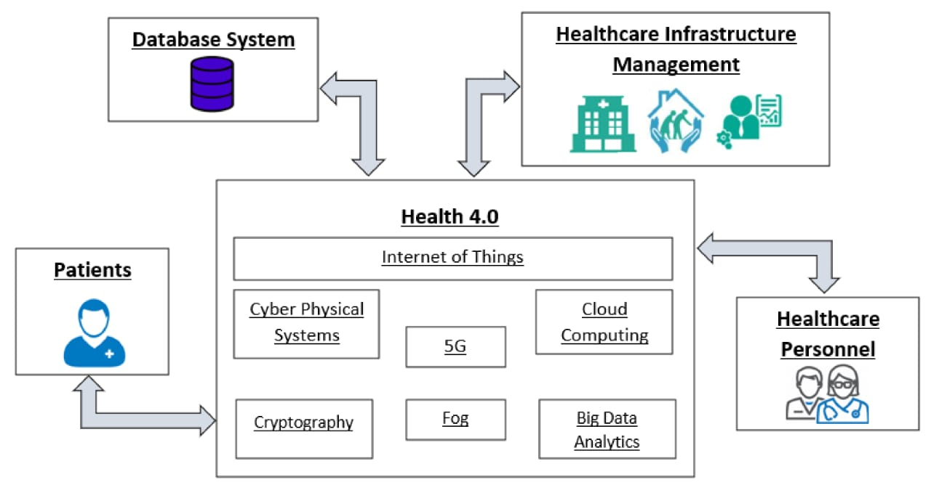
PROPOSED SYSTEM
HOME
LOGIN
REGISTER
.
TRANSFER THE MONEY TO ANOTHER ACCOUNT
DASHBOARD
UPDATING THE AMOUNT

Slide 6
MODULES OF THE PROJECTS
Patient Monitoring Module
Data Processing Module
Communication Module
Alert & Notification Module
Data Visualization Module
Prediction and Context Awareness Module

Slide 7
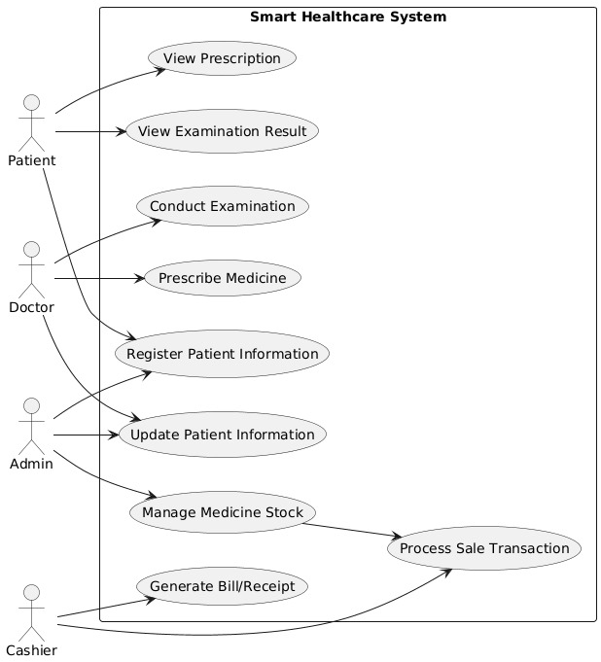
PATIENT MONITORING MODULE
USE CASE DIAGRAM

Slide 8
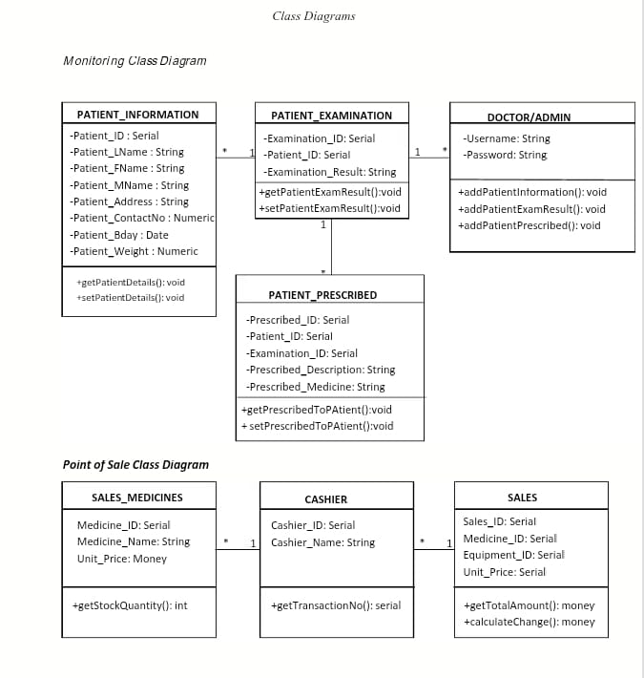
PATIENT MONITORING MODULE
CLASS DIAGRAM

Slide 9
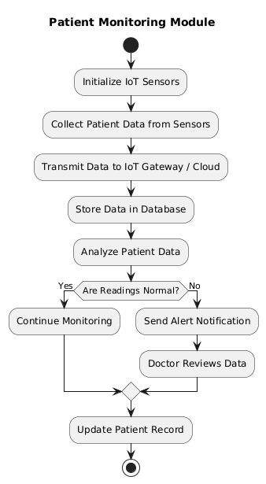
PATIENT MONITORING MODULE
ACTIVITY DIAGRAM

Slide 10
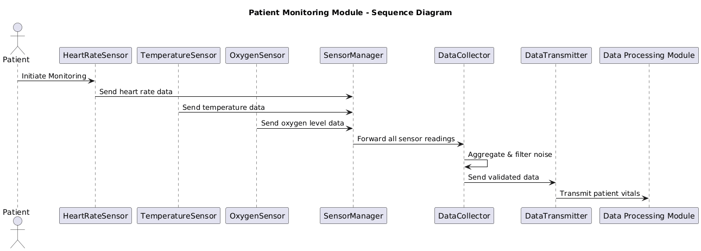
PATIENT MONITORING MODULE
SEQUENCE DIAGRAM

Slide 11
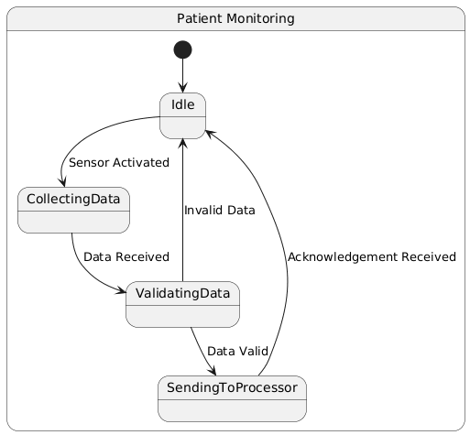
PATIENT MONITORING MODULE
STATE MACHINE DIAGRAM

Slide 12
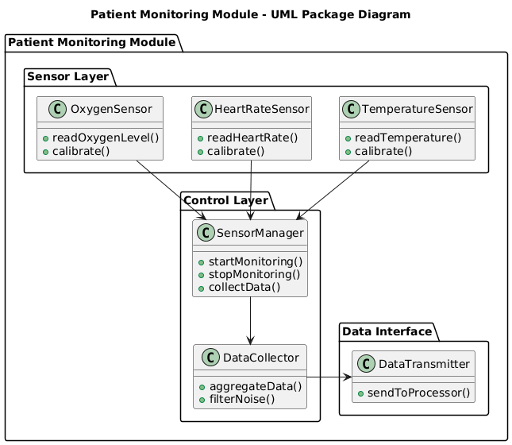
PATIENT MONITORING MODULE
PACKAGE DIAGRAM

Slide 13
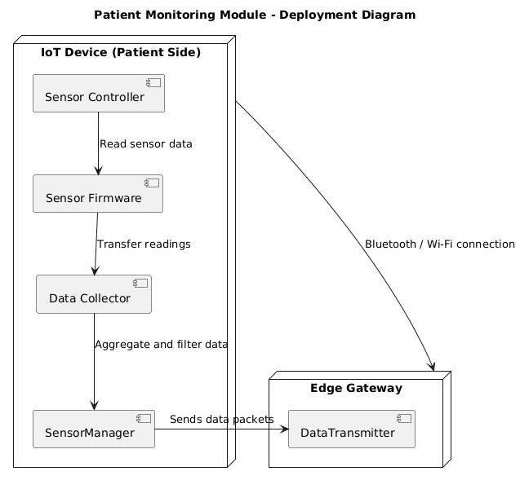
PATIENT MONITORING MODULE
DEPLOYMENT DIAGRAM

Slide 14
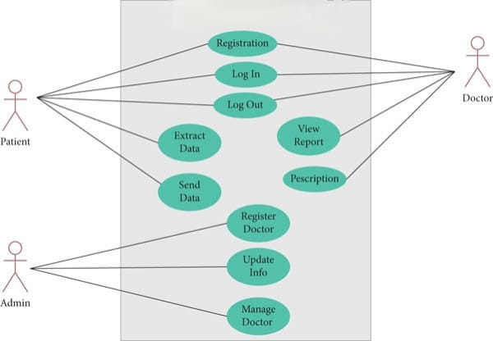
DATA PROCESSING MODULE
USE CASE DIAGRAM

Slide 15
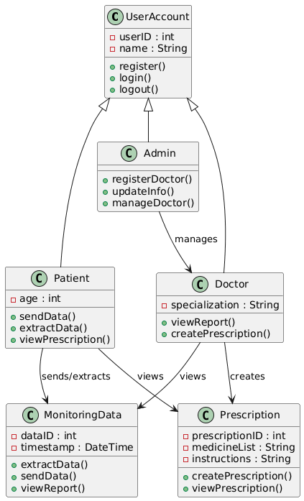
DATA PROCESSING MODULE
CLASS DIAGRAM

Slide 16
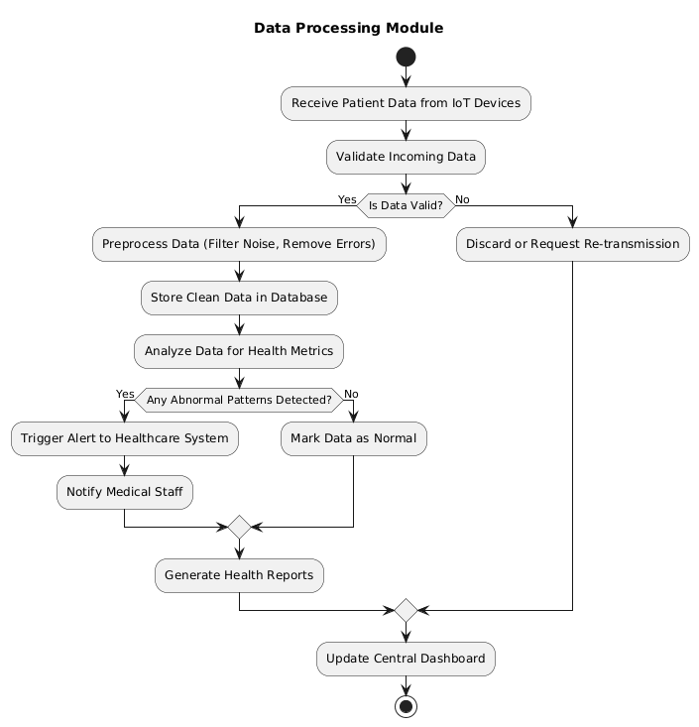
DATA PROCESSING MODULE
ACTIVITY DIAGRAM

Slide 17
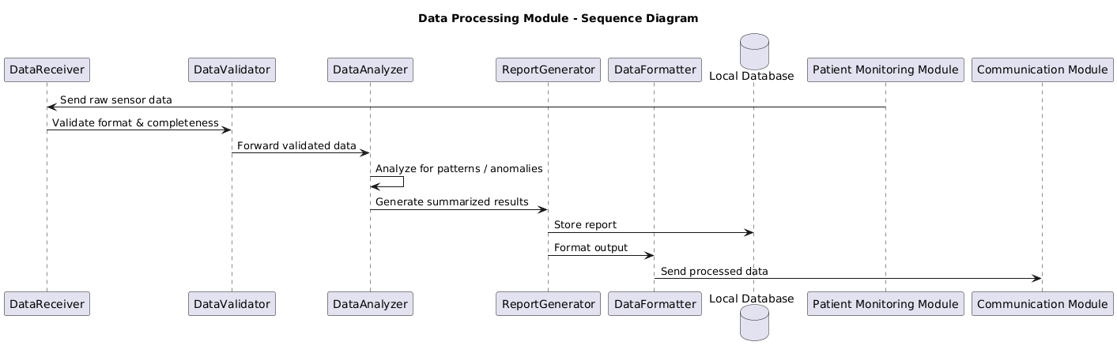
DATA PROCESSING MODULE
SEQUENCE DIAGRAM

Slide 18
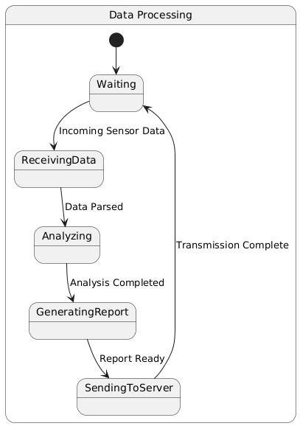
DATA PROCESSING MODULE
STATE DIAGRAM

Slide 19
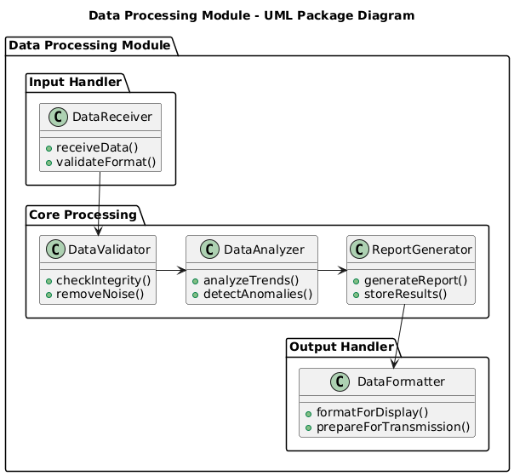
DATA PROCESSING MODULE
PACKAGE DIAGRAM

Slide 20
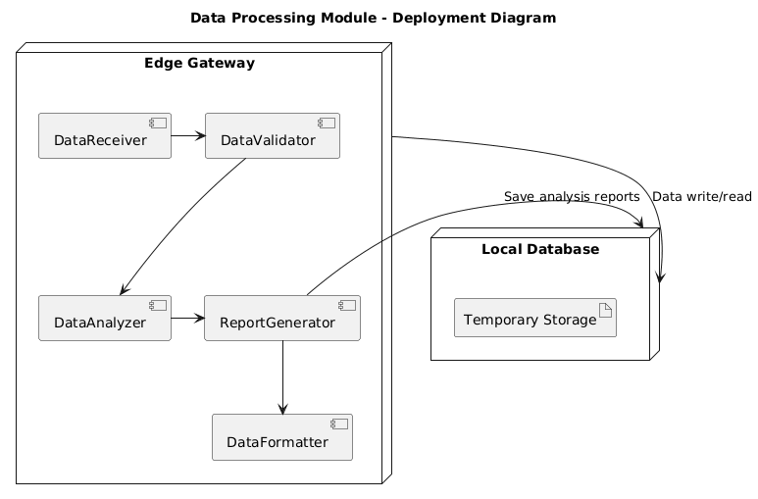
DATA PROCESSING MODULE
DEPLOYMENT DIAGRAM

Slide 21
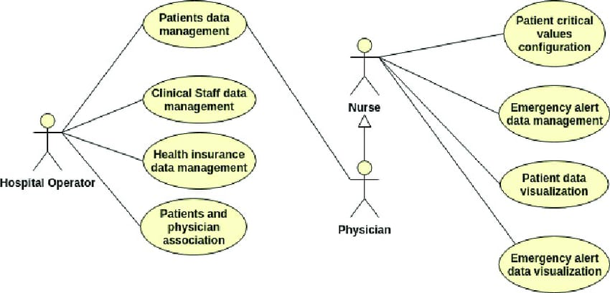
COMMUNICATION MODULE
USE CASE DIAGRAM

Slide 22
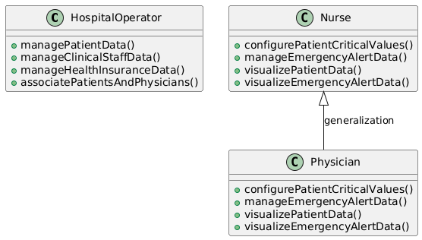
COMMUNICATION MODULE
CLASS DIAGRAM

Slide 23
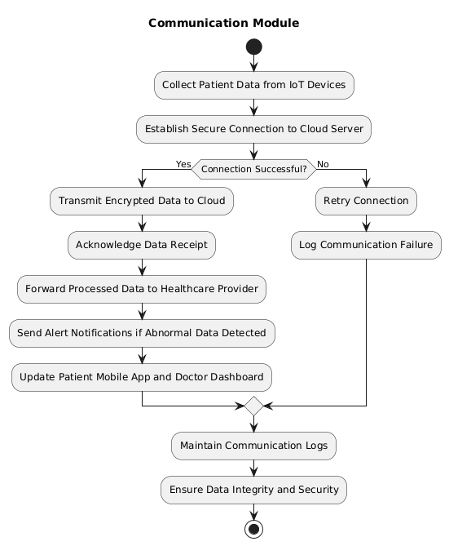
COMMUNICATION MODULE
ACTIVITY DIAGRAM

Slide 24
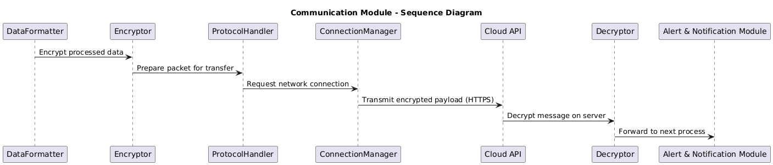
COMMUNICATION MODULE
SEQUENCE DIAGRAM

Slide 25
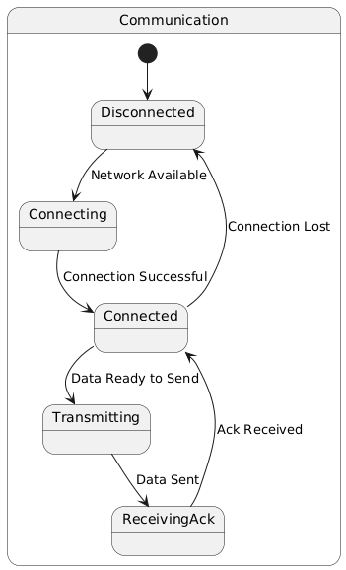
COMMUNICATION MODULE
STATE DIAGRAM

Slide 26
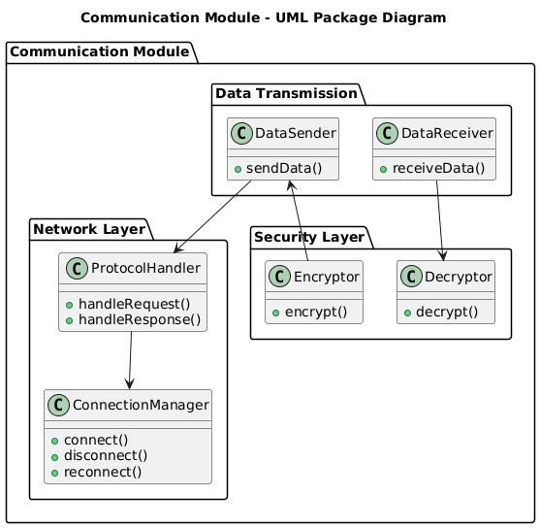
COMMUNICATION MODULE
PACKAGE DIAGRAM

Slide 27
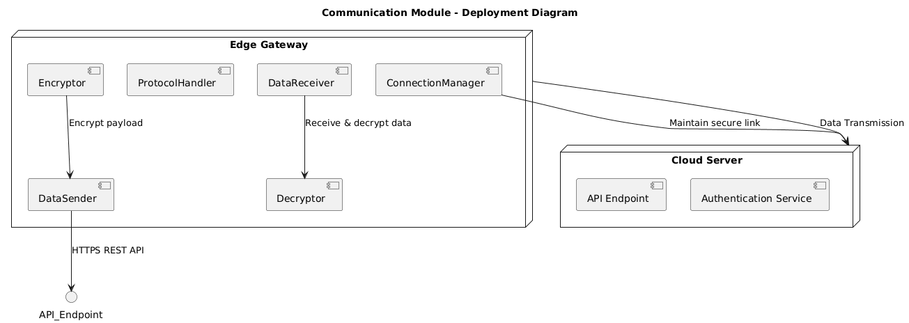
COMMUNICATION MODULE
DEPLOYMENT DIAGRAM

Slide 28
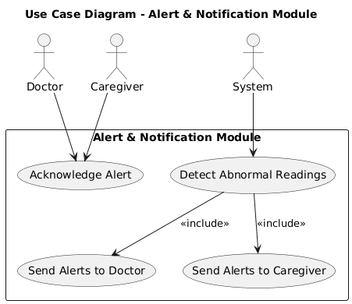
ALERT &NOTIFICATION MODULE
USE CASE DIAGRAM

Slide 29
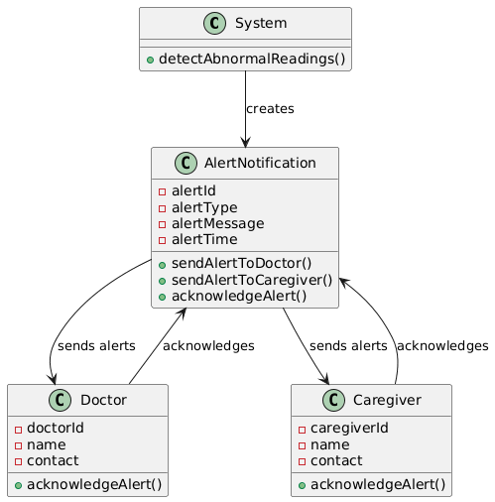
ALERT &NOTIFICATION MODULE
CLASS DIAGRAM

Slide 30
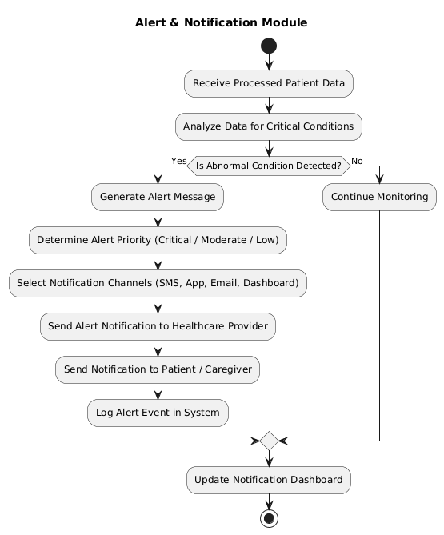
ALERT &NOTIFICATION MODULE
ACTIVITY DIAGRAM

Slide 31
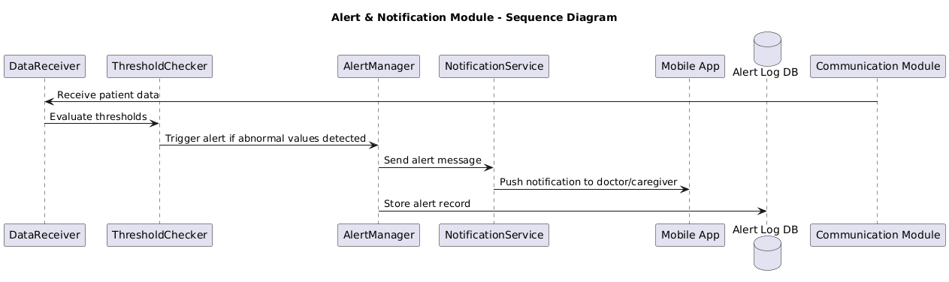
ALERT &NOTIFICATION MODULE
SEQUENCE DIAGRAM

Slide 32
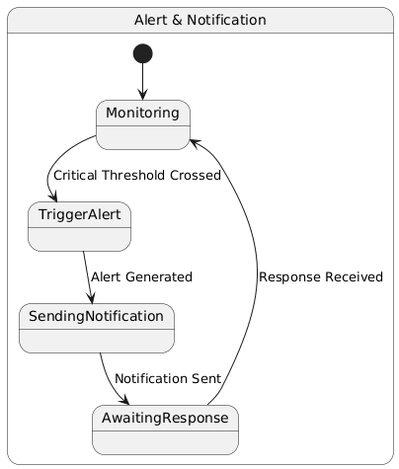
ALERT &NOTIFICATION MODULE
STATE DIAGRAM

Slide 33
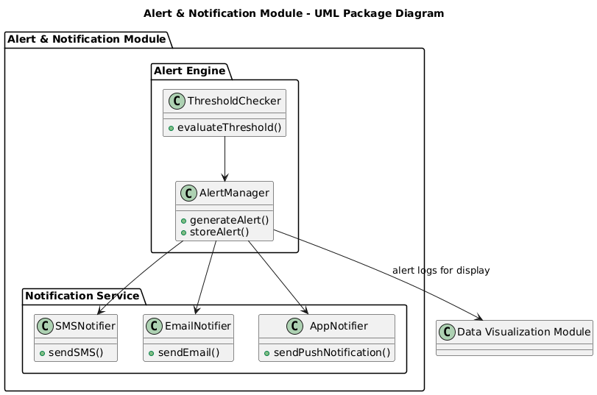
ALERT &NOTIFICATION MODULE
PACKAGE DIAGRAM

Slide 34
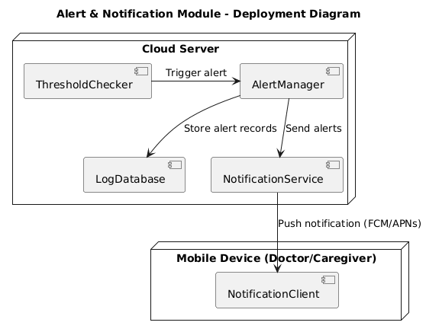
ALERT &NOTIFICATION MODULE
DEPLOYMENT DIAGRAM

Slide 35
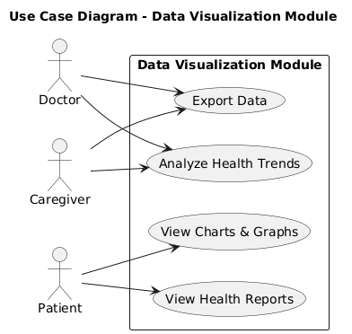
DATA VISUALIZATION MODULE
USE CASE DIAGRAM

Slide 36
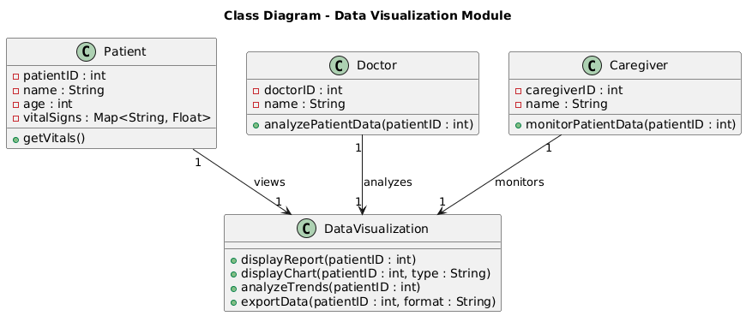
DATA VISUALIZATION MODULE
CLASS DIAGRAM

Slide 37
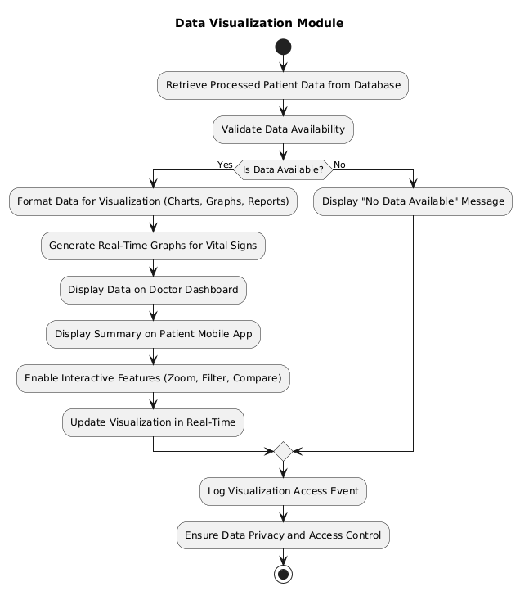
DATA VISUALIZATION MODULE
ACTIVITY DIAGRAM

Slide 38
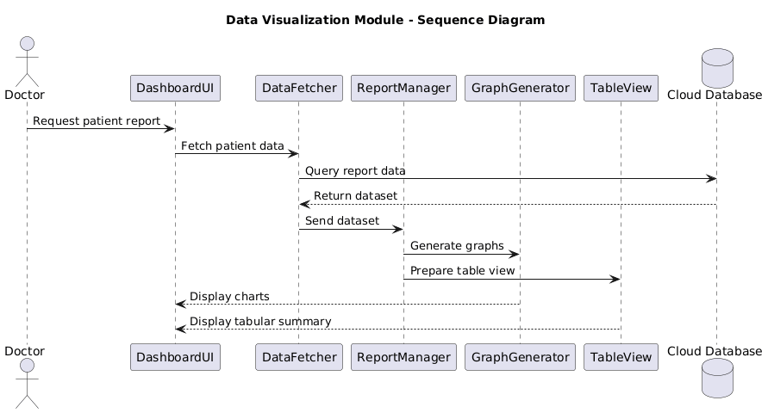
DATA VISUALIZATION MODULE
SEQUENCE DIAGRAM

Slide 39
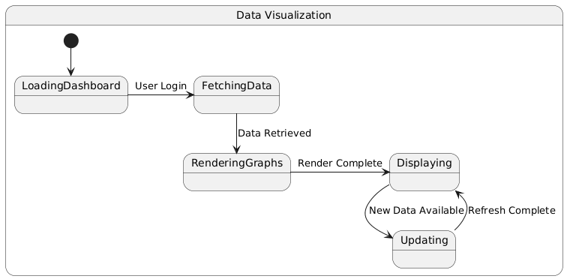
DATA VISUALIZATION MODULE
STATE DIAGRAM

Slide 40
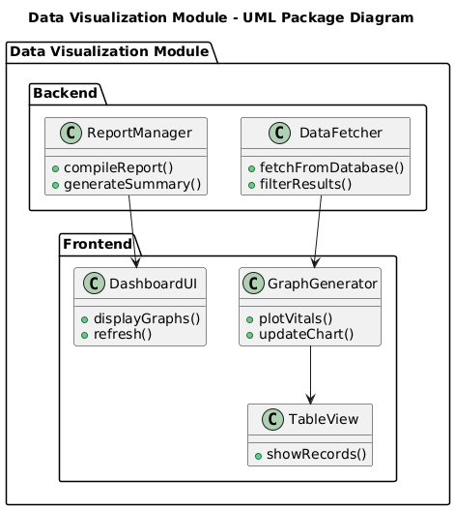
DATA VISUALIZATION MODULE
PACKAGE DIAGRAM

Slide 41
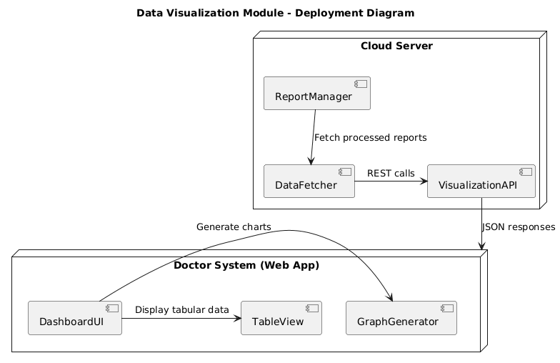
DATA VISUALIZATION MODULE
DEPLOYMENT DIAGRAM

Slide 42
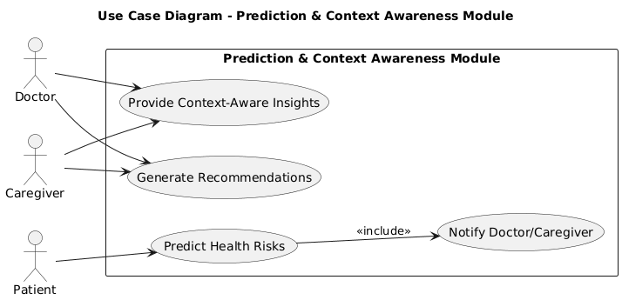
PREDICTION AND CONTEXT AWARNESS MODULE
USE CASE DIAGRAM

Slide 43
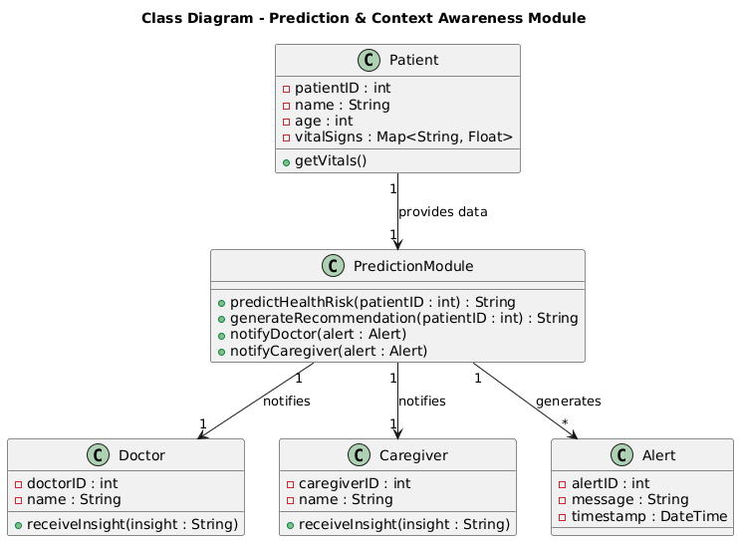
PREDICTION AND CONTEXT AWARNESS MODULE
CLASS DIAGRAM

Slide 44
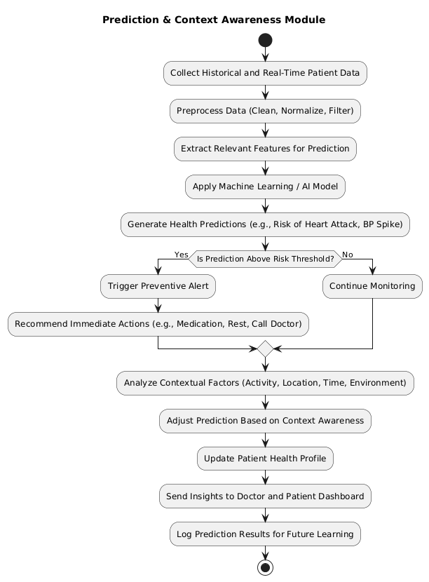
PREDICTION AND CONTEXT AWARNESS MODULE
ACTIVITY DIAGRAM

Slide 45
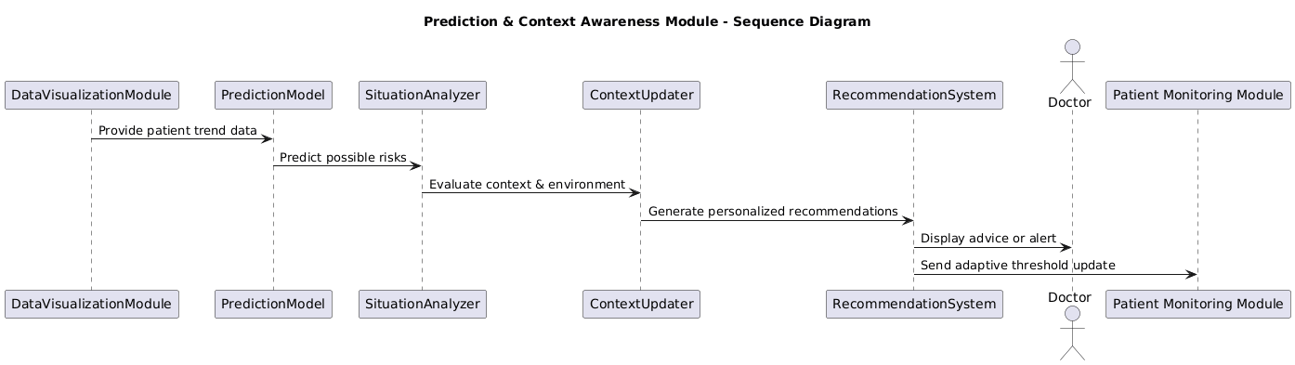
PREDICTION AND CONTEXT AWARNESS MODULE
SEQUENCE DIAGRAM

Slide 46
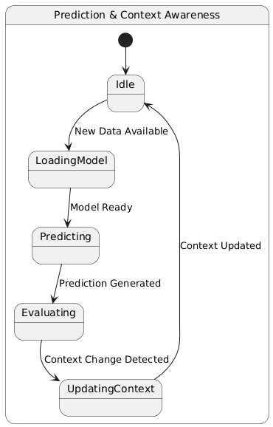
PREDICTION AND CONTEXT AWARNESS MODULE
STATE DIAGRAM

Slide 47
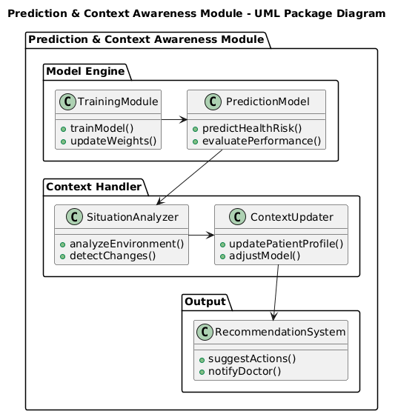
PREDICTION AND CONTEXT AWARNESS MODULE
PACKAGE DIAGRAM

Slide 48
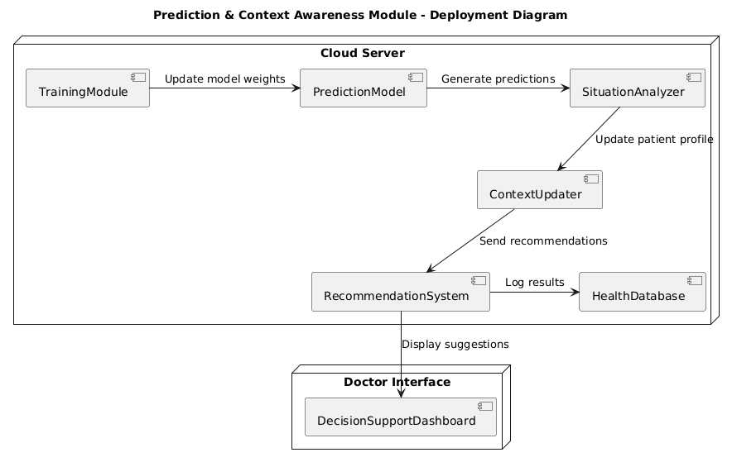
PREDICTION AND CONTEXT AWARNESS MODULE
DEPLOYMENT DIAGRAM

Slide 49
CONCLUSION
The Smart Healthcare Monitoring System enables real-time monitoring, ensuring timely interventions and enhanced patient safety. It processes raw sensor data into accurate, actionable health information for informed decision-making. Prompt alerts and notifications allow doctors and caretaker to respond quickly during emergencies.

Slide 50
THANK YOU !!!!

